Slide 1
Service Orientation – Session I: Introduction and Fundamentals

Slide 2
Session I: Contents
Service orientation
  Motivation
  Elements of
  Contrasting other architectural styles
  Examples of service oriented architectures
Web services
  Introduction and motivation
  An evolutionary perspective

Slide 3
Service Orientation

Slide 4
What is a Software Architecture Style?
An architectural style defines:
  a family of systems or a class of architectures in terms of a pattern of structural organization
  a vocabulary of components and connectors, with constraints on how they can be combined
  Is found repeatedly in practice
Notes:
In other words, architecture styles are “design for the structure and interconnection within and between software systems.

Slide 5
Software Architectural Styles
Popular styles:
  Resource oriented architectures
  Object oriented architectures
References
      [Shaw & Garlan, “Software Architecture: Perspectives on an Emerging Discipline”, 1996]
      [Clements, Kazman & Klein, “Evaluating Software Architecture”, 2002]

Slide 6
Resource-Oriented Architectures
Involve retrieving particular resource instances
Some examples are:
  Retrieving a HTML page using HTTP GET request
  Retrieving a database table row using a SQL SELECT command
Resource instances are identified by some sort of “address” data included with the request. Some examples are:
  A HTTP URL
  a FROM clause in a SQL SELECT statement
Resources have State (current values of data), and Identity (implicit from the input “query” data used to find/select the resource)
Encoding “parameters” into addresses can become difficult for complex query resources

Slide 7
ROA - 2
Retrieving a resource creates a (detached) snapshot of its current state on the client side
“Master copy” of the resource data remains on the server
Usually can “cache” the resource data for later reuse within specified expiration times without having to re-retrieve the data

Slide 8
ROA - 3
Updates to resources typically involve replacing the previous copy of the data with a new copy (for example HTTP PUT), but there may also be some command verbs for doing “partial updates” (for example HTTP POST or SQL UPDATE)
Variations in this architecture style involve “distributed resource copies” where multiple copies of the resource data are kept, and changes and amendments are broadcast to keep all copies in synchronization – often using Publish/Subscribe messaging techniques

Slide 9
Object Orientation
State information is on the server in form of objects which have a clearly defined identity (unique).
Server can manage these object “resources” efficiently via passivation and other techniques.
Can be used with messaging (Message Driven Beans) but is typically call oriented in nature.
IIOP(CORBA) and RMI (J2EE) are examples.

Slide 10
OOA - 2
All state information is held on the server side
Each access to the object involves a network call and round-trip communication
Design patterns have evolved to provide ways to minimize network calls through bulk data retrieval and smart proxies that cache data.

Slide 11
OOA - 3
Usually use specific non-Internet-friendly protocols such as IIOP, DCOM or RMI for communication
Usually provides pass-by-reference facilities for all non built-in types
Marshalling object references generally precludes using different types of software on client-side and server-side
  IIOP and IORs are the exception but where is CORBA today?

Slide 12
Issues with these “legacy styles”
Both call & message orientation introduces tight coupling which is undesirable.
  Object Identity is fixed and is tied in with location.
  Change of an event type would necessitate changing all the subscribers.
These systems cannot be made adaptive in nature because of the static hardwired nature of the interactions.
  CORBA DII is the only exception to this but how much has that been used?
Difficulties in reuse and sharing of data and programs cause redundancy, wasted effort, and integrity violations
  Arises from the static nature of the binding.
Closed: typically, use a vendor’s proprietary software, and cannot cooperate with other systems
The level of IT abstraction is inadequate to describe the offerings
  Cannot talk about applications because multiple applications work together to offer customers services.
  Certainly cannot talk about lower level abstractions such as components and objects because they may mean nothing to a customer of the IT organization.

Slide 13
What is Service-Oriented Architecture?
Service-Oriented Architecture (SOA) is an architectural style. Applications built using an SOA style deliver functionality as services that can be used or reused when building applications or integrating within the enterprise or trading partners.

Slide 14
SOA
Uses open standards to integrate software assets as services
Standardizes interactions of services
Services become building blocks that form business flows
Services can be reused by other applications

Slide 15
The SOA Framework
Discovery
Services
Find Service
Publish Service
Description
Client
Use Service
Service
Provider

Slide 16
Call flow to a service
2. Discovery
1. Publishing
3. YP Lookup
Registry
Client
4. Request
Service Providing
Peers
4. Request
5. Async Reply

Slide 17
What is a Service?
A service is a reusable component that can be used as a building block to form larger, more complex business-application functionality.
A service may be as simple as “get me some person data,” or as complex as “process a disbursement.”

Slide 18
What is a Service?
A service provides a discrete business function that operates on data. Its job is to ensure that the business functionality is applied consistently, returns predictable results, and operates within the quality of service required.

Slide 19
What is a Service?
How the service is implemented, and how a user of the service accesses it, are limited only by the SOA infrastructure choices of the enterprise.
From a theory point of view, it really doesn’t matter how a service is implemented.

Slide 20
Characteristics of a Service
Supports open standards for integration: Although proprietary integration mechanisms may be offered by the SOA infrastructure, SOA’s should be based on open standards. Open standards ensure the broadest integration compatibility opportunities.

Slide 21
Characteristics of a Service
Loose coupling: The consumer of the service is required to provide only the stated data on the interface definition, and to expect only the specified results on the interface definition. The service is capable of handling all processing (including exception processing).

Slide 22
Characteristics of a Service
Stateless: The service does not maintain state between invocations. It takes the parameters provided, performs the defined function, and returns the expected result. If a transaction is involved, the transaction is committed and the data is saved to the database.

Slide 23
Characteristics of a Service
Location agnostic: Users of the service do not need to worry about the implementation details for accessing the service. The SOA infrastructure will provide standardized access mechanisms with service-level agreements.

Slide 24
Summary of SOA Elements
Loose coupling: focus should be on high-level contractual relationships
Implementation neutrality: the interface is what should matter
Flexible configurability: late binding of components
Long lifetime: components should exist long enough to be discovered, to be relied upon, and to engender trust in their behavior
Granularity: interactions and dependencies should occur at as high a level as possible
Teams: computation in open systems should be conceptualized as business partners working as a team

Slide 25
SOA Benefits
The services model mimics business needs better than objects or resources
  IT Services (virus detection and elimination service)
  Marketing services (promotional campaigns, brand marketing programs etc.)
  Accounting services (Audits, Quarterly statements etc.)
Loose coupling between consumer and provider
  Allows us to improve availability by having redundant providers.
Dynamic binding allows the use of the latest services that are most useful to the task at hand.
  In a highly adhoc networked environment, “discovery” becomes critical – yellow pages model over white pages.
Allows you to leverage existing IT assets – is a evolutionary architecture not a revolutionary one.

Slide 26
SOA Benefits - 2
More cost efficient from an IT perspective:
  Computing as a utility rather than as infrastructure
  Use as you need model
  Reuse
Flexibility
  Compose services on the fly

Slide 27
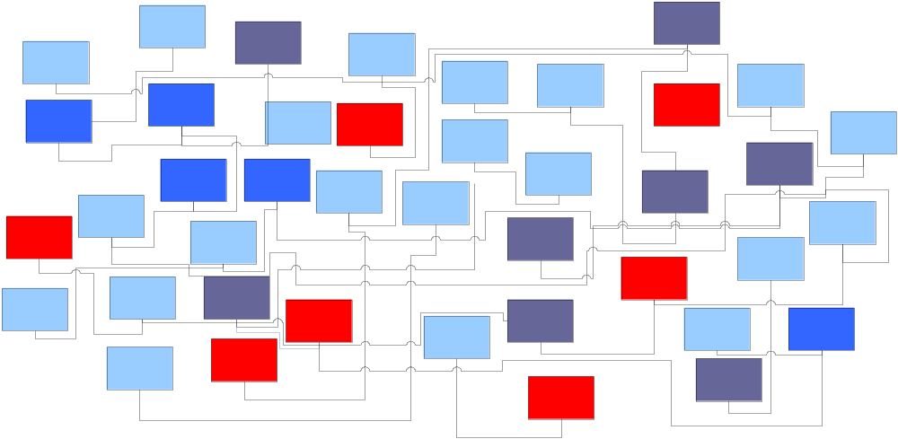
Legacy Integration

Slide 28
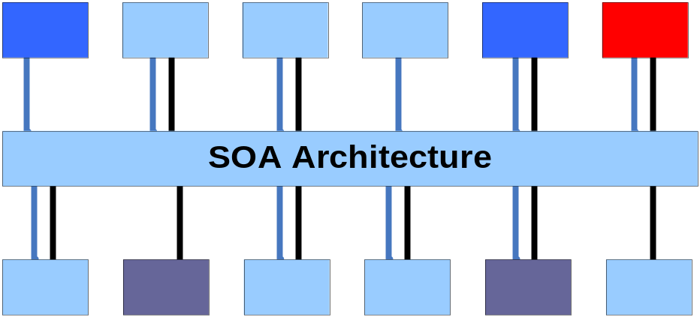
SOA Integration

Slide 29
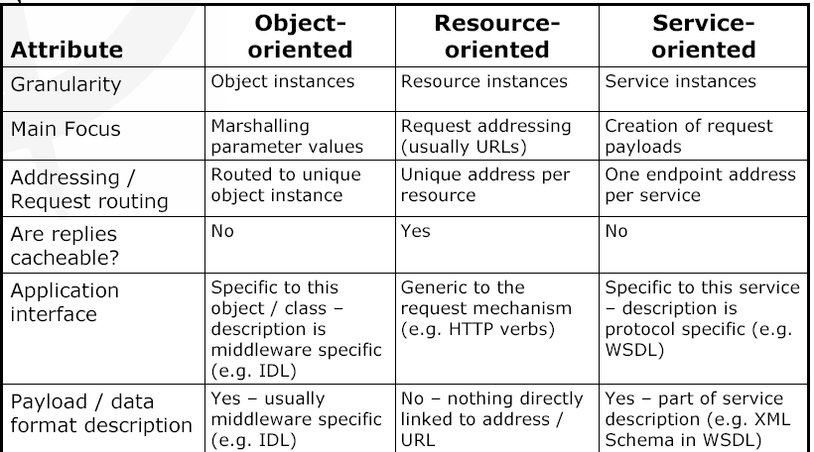
Comparison of Architectural Styles

Slide 30
Choosing between them
Object-oriented distributed system architectures are usually best for “closed” systems controlled by a single organization.
  Generally involve tight coupling between client and server due to object reference semantics
Resource-oriented approaches revolve around the cache-ability of resource data, so are only typically used for read-only, read-mostly or idempotent operations, or results that have a “validity window” or “expiration period”
Service-oriented approaches are generally the most flexible, especially with full interface and payload descriptions using WSDL

Slide 31
Examples of SOA Frameworks
Jini
  Java based
  Incorporates discovery, leasing, anonymous routing.
  Takes advantage of code mobility afforded by Java
Web services
  Open standards based
    Uses XML as the data description format
    Usually runs on open transports such as http.

Slide 32
Summarizing
… a service?
A repeatable business
task – e.g., check
customer credit; open
new account
… service orientation?
A way of integrating your
business as linked
services
and the outcomes that
they bring
… service oriented
architecture (SOA)?
An IT architectural style
that supports
service orientation
… a composite
application?
A set of related &
integrated services that
support a business process
built on an SOA

Slide 33
Web Services

Slide 34
Web Processes
Web processes are the next generation of workflow technology to facilitate the interaction of organizations with markets, competitors, suppliers, customers etc. supporting enterprise-level and core business activities
  encompass the ideas of both intra and inter organizational workflow.
  can use BPEL4WS to represent composition.

Slide 35
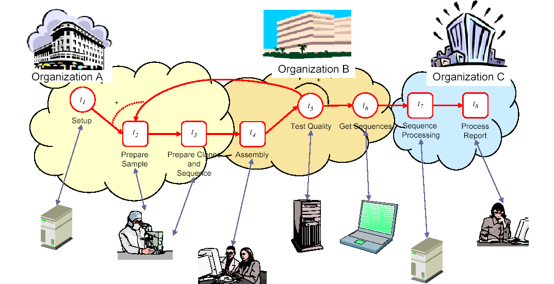
How will they be used?

Slide 36
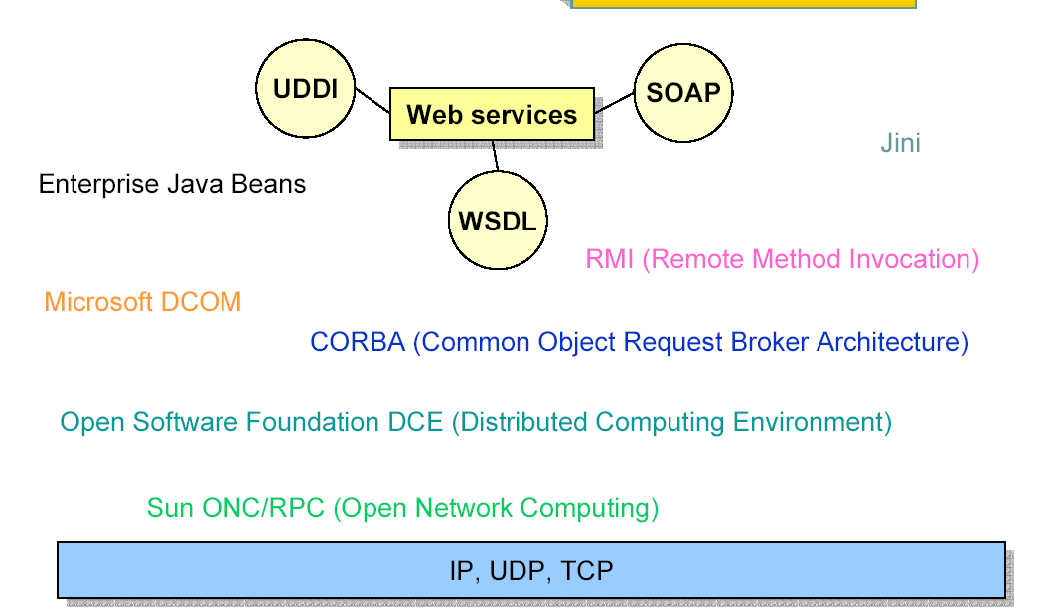
Why Standardization?

Slide 37
The next generation Internet
HTML and browsers were computer to human communication
  Universal human to application access
Web services are for program to program communication
  Separated by program, machine, operating system and organizational boundaries
  Universal application to application access

Slide 38
What is a Web service?
Application capability, function or operation exposed to other programs via open, interoperable standards
  “payloads” defined as XML documents
  “transports” over http or other open Internet protocol
Can be access from any programming language, hardware platform or operating system

Slide 39
What is a “Good Web Service”?
“self describing”
  XML Schema or DTD for grammar of payload
  human readable instances
discoverable
  UDDI, WS-Inspection, or some other method of advertising availability
  Realize promise of many to many integrations that are enabled by a web service (one to one ad hoc integrations can be done with earlier technology)
“coarse grained”
  Large documents representing entire business events or business objects
  e.g. CRUD operations: CreateOrder, ReadOrder, UpdateOrder, DeleteOrder
  NOT operations such as SetPrice(), SetProduct(), SetCustomer(), CompleteOrder()
asynchronous
  When appropriate (often for large scale work)
Notes:
We’ll talk a lot more about each of these aspects later

Slide 40
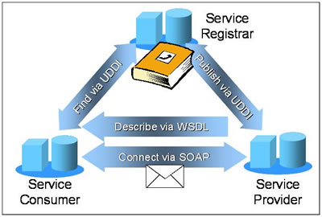
Base Protocols in Web Services
Source: CBDI

Slide 41
End of Session I – Questions?

